Slide 1
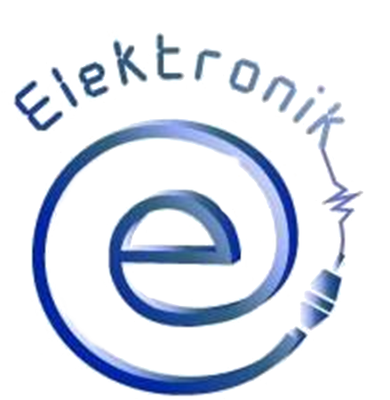
ICT in future - housework and daily life
Presentation prepared by Polish students

Slide 2
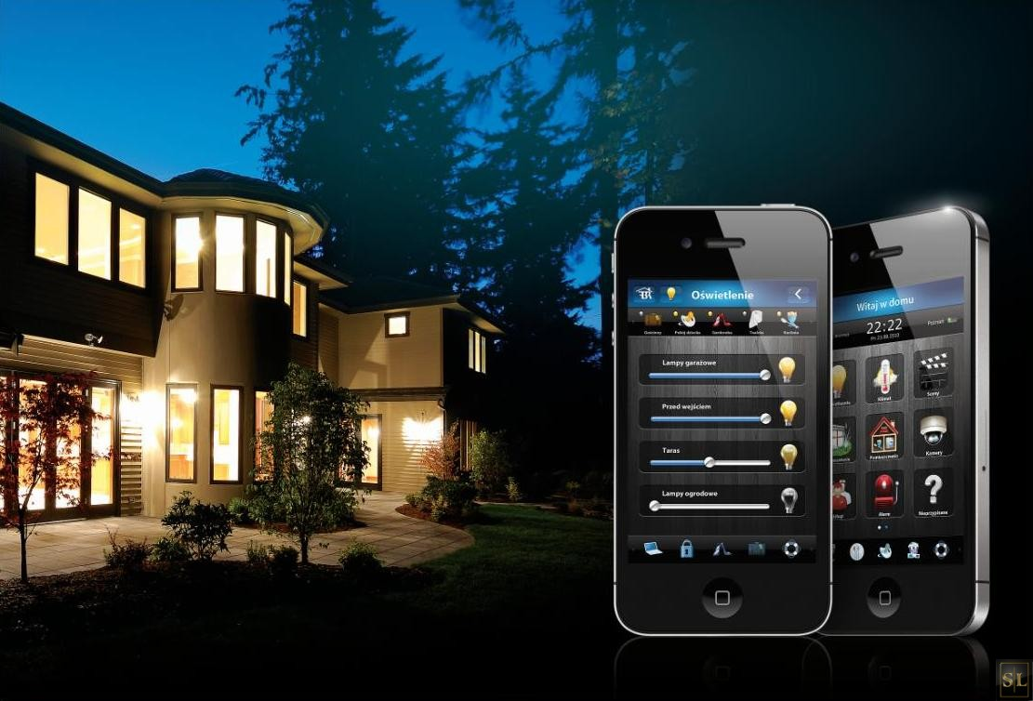
- Polecenia wydawane LiLi mogą być prostymi komendami typu włącz/wyłącz czy otwórz/zamknij, jak i zadaniami bardziej skomplikowanymi - mówi Maciej Fiedler, dyrektor ds. rozwoju Fibar Group, producenta bezprzewodowego systemu inteligencji budynków Fibaro. Dzięki temu, że LiLi (a dokładniej centralka Home Center 2, z którą LiLi się komunikuje) zna aktualny stan poszczególnych urządzeń oraz ich rozmieszczenie w domu, potrafi odpowiednio zareagować także na polecenie takie, jak na przykład zalecenie obniżenia temperatury w sypialni o trzy stopnie czy podniesienia rolet o 30 proc. Wirtualna asystentka jest także w stanie zinterpretować indywidualne nazewnictwo poszczególnych pomieszczeń czy sprzętów. LiLi nie tylko realizuje nasze głosowe polecenia, ale także w czasie rzeczywistym logicznie na nie odpowiada. To pozwala na doprecyzowanie określonych poleceń, jeśli są niejasne. Przykładowo w sytuacji, gdy każemy włączyć światło, LiLi dopyta, o które pomieszczenie czy lampę nam chodzi. Jeśli z kolei stwierdzimy, że należy włączyć ogrzewanie, doprecyzuje, czy chodzi nam o cały dom, czy tylko wybraną strefę. A jeśli na przykład kilkukrotnie błędnie coś wypowiemy lub zapomnimy, jak nazwaliśmy pomieszczenia albo urządzenia, zapyta, czy ma wymienić nazwy wszystkich pokoi w danej sekcji.
LiLi – Smart House
The Fibaro System will transform every house into a self-regulating mechanism, which will facilitate the lives of all members of the household. Thanks to that solution, electrical devices in your house can communicate, providing you with a wide range of solutions and applications.

Slide 3
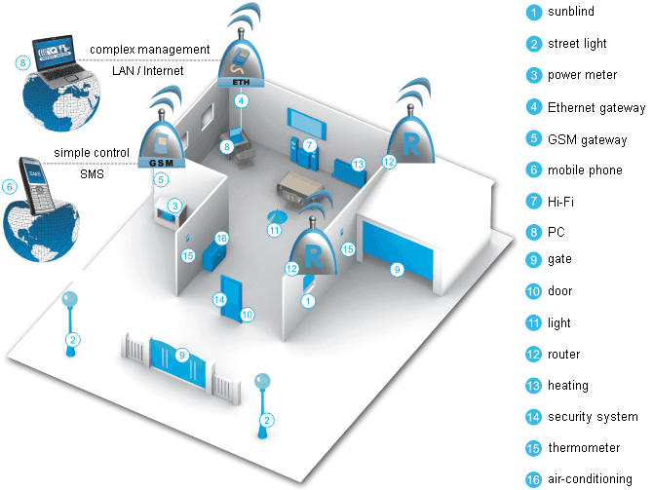
LiLi – Smart House
Lili is virtual assistent that allow us to control our house through voice commands.To communicate with Lily, you have to install application on your smartphone and set it properly. Now you are able to control everything.

Slide 4
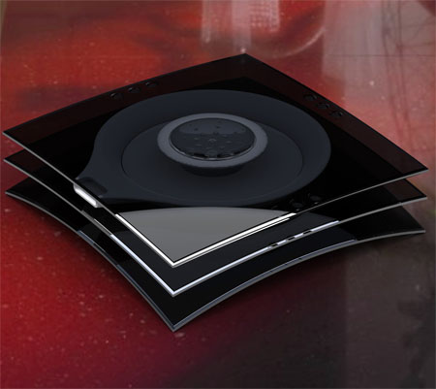
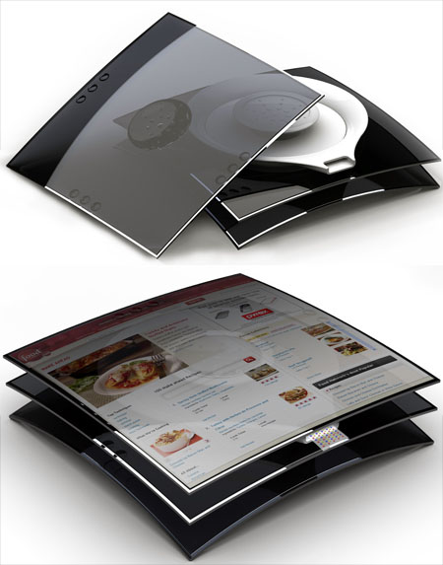
Teaser
Teaser is a device created to test recipes and tastes of the food before preparing it. In this way no-one’s work and no ingredients will be wasted.
It has a slim touch-screen display and printing system but it does not print pages with text but edible ribbons of taste. It’s something great!

Slide 5
Smart Finger
Long time ago people in different countries used their parts of the body to measure and calling it different names. Now we have common units, but it’s hard to get rid of old habits. That’s why a group of Asian scientists got to work.

Slide 6
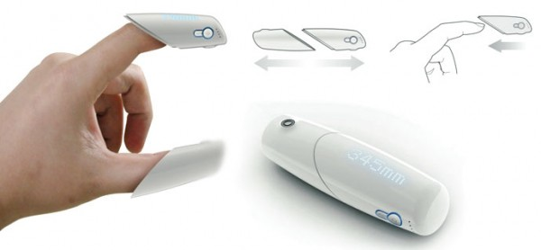
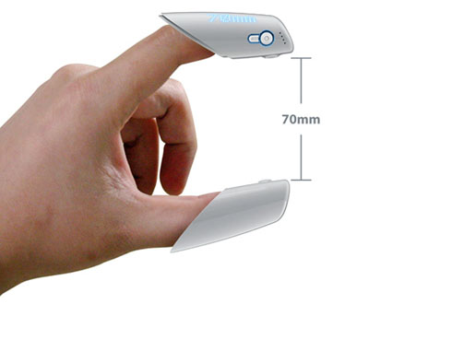
Smart Finger
Smart Finger is the way to fill the gap between digital accuracy and human approximations.
It is a device that caps your any 2 fingers and uses the signals relayed between them to calculate the measurement.
The distance is calculated on the basis of the time taken by the signal to beam from one finger tip to the other and back.
The measured distance is displayed through LED

Slide 7
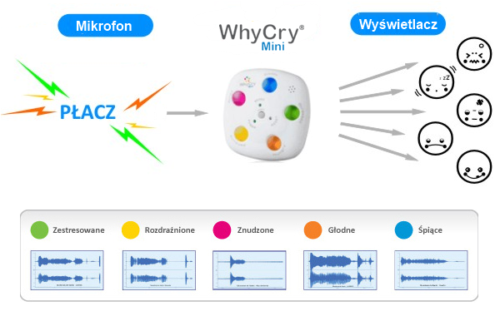
Baby cry translator
It seems to be impossible, but somehow someone did invent baby cry translator and put it in little device called "Why Cry Mini”

Slide 8
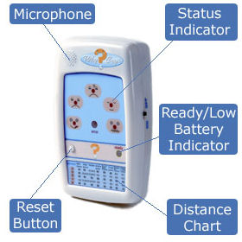
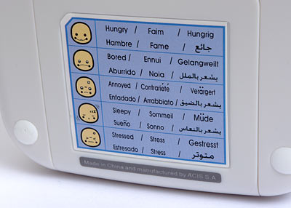
Baby cry translator
It should be kept in the right distance from a child, then it will register the type of cry and after 10 seconds it shows us if baby is sleepy, hungry, bored, vexed or stressed.

Slide 9
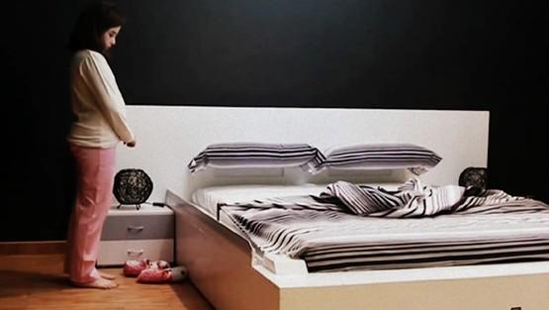
Smart Bed
It is a bed which make itself after you get up. It will save time of everybody every morning in the near future.
video

Slide 10
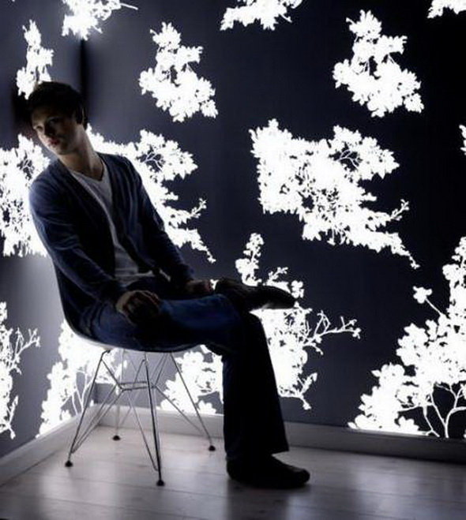
LED wall wallpaper
Interior Architects have long tried to provide the offices and homes with the wall on which you can display any light scenes. Philips created wall panels with built-in LEDs.

Slide 11
LED wall wallpaper
The panels can display visuals corresponding to the music played inside, changing colors in the bar. On the walls, you can also display dynamic media.

Slide 12
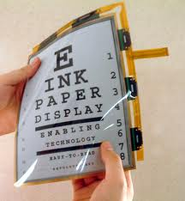
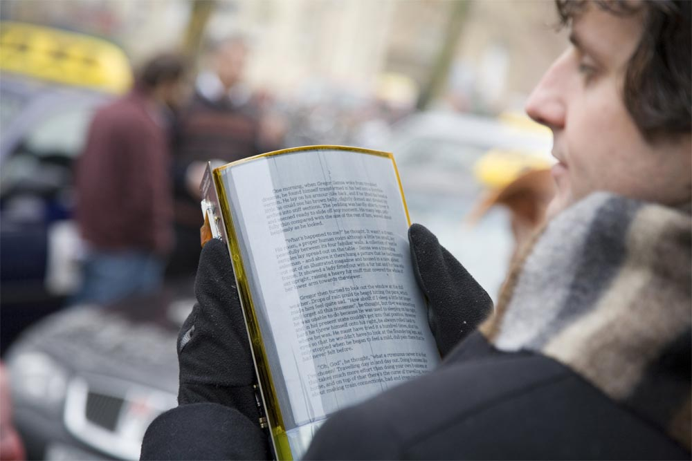
E-paper
Electronic paper and electronic ink are display technologies which are designed to mimic the appearance of ordinary ink on paper.

Slide 13
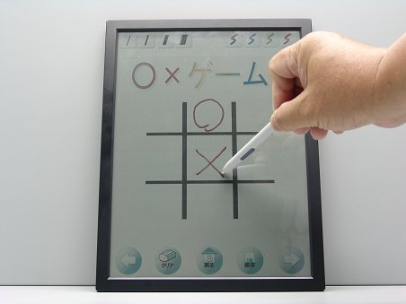
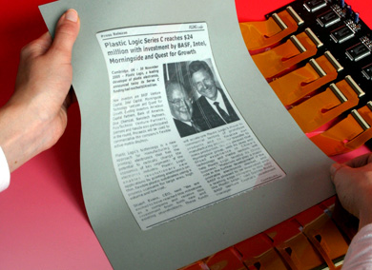
E-paper
Unlike conventional backlit flat panel displays which emit light, electronic paper displays reflect light like ordinary paper, theoretically making it more comfortable to read to conventional displays. An ideal e-paper display can be read in direct sunlight without the fading image.

Slide 14
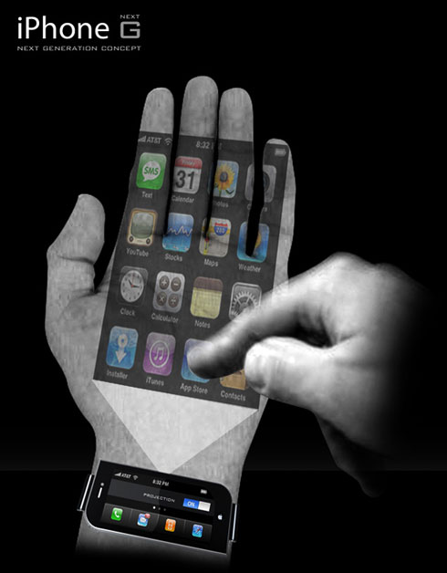
Phone on your hand
When we still wait for synthetic skin that will be able to be displayed, designers think about armband phone that displays images on our hands by projector or when we need simple functions it has a small screen.

Slide 15
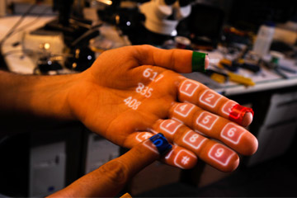
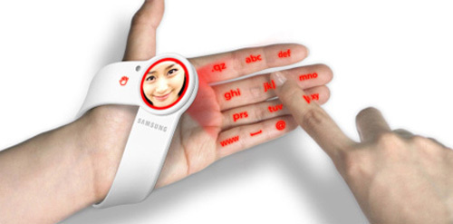
Phone on your hand
It will be a very handy solution

Slide 16
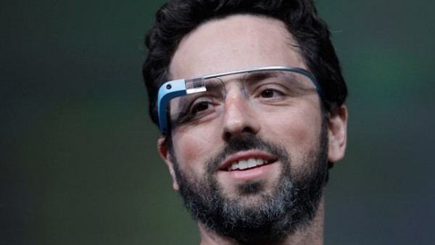
Google glass
video
Project Glass is a research and development program by Google to develop an augmented reality head-mounted display (HMD). Project Glass products would display information in smartphone-like format hands-free and could interact with the Internet via natural language voice commands.

Slide 17
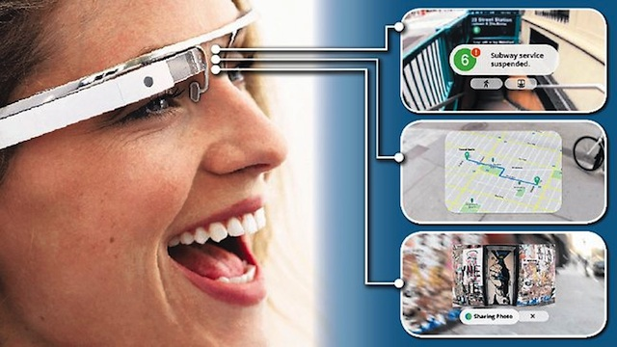
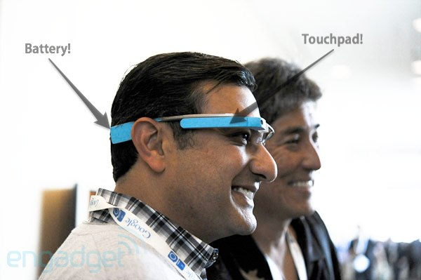
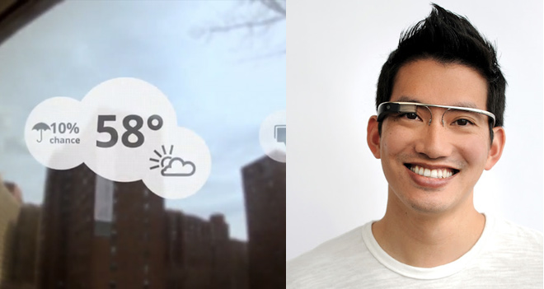
Google glass

Slide 18
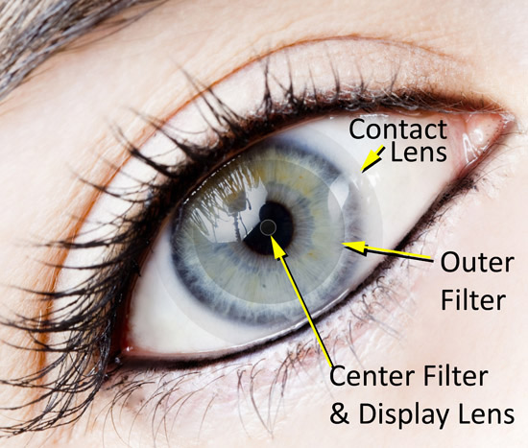
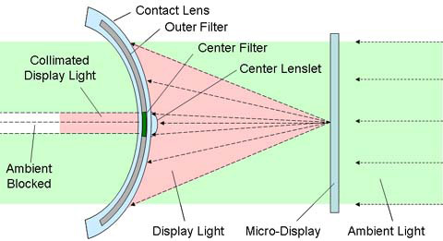
Innovega iOptik
iOptik augmented reality system which combines contact lens with a low-profile head mounted display.
You will be able to watch films or browse Internet.

Slide 19
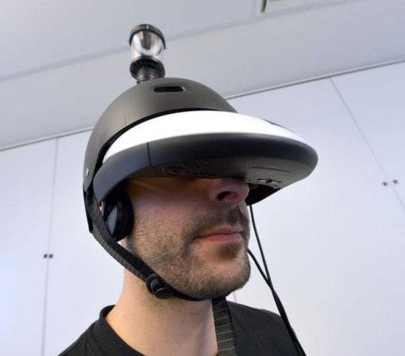
Eyes around the head
FlyVIZ is a special helmet resembling that of a virtual reality equipment that has been designed to provide the wearer view of 360 degrees. Wearing something like this on your head, you really have eyes in the back of the head.

Slide 20
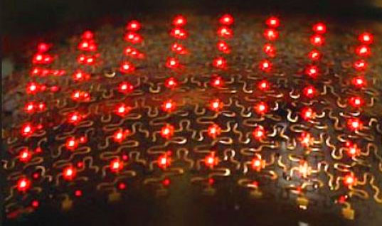
Leds tattoos
A light-emitting diode tattoo is a type of body modification similar to a tatoo, but specifically involves implantation of technologically based materials versus traditional ink injection into the layers of the skin.

Slide 21
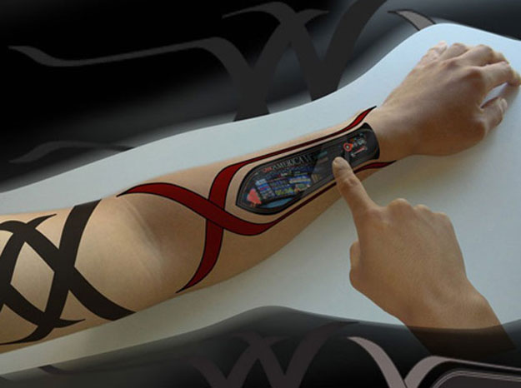
Leds tattoos
How it works?
There are flexible leds, that you can safely implant in your skin. In near future each of the tattoo artist will use it. We will be able to change our „ex” name in a few seconds. Tattoo will be movable and shine finely.

Slide 22
Thank you for attention
Presentation prepared by Polish students

